Slide 1
Multi-agent structures
and agentic mesh with A2A

Slide 2
Agents in multi-agent structures can be organized into different hierarchical structures

Slide 3

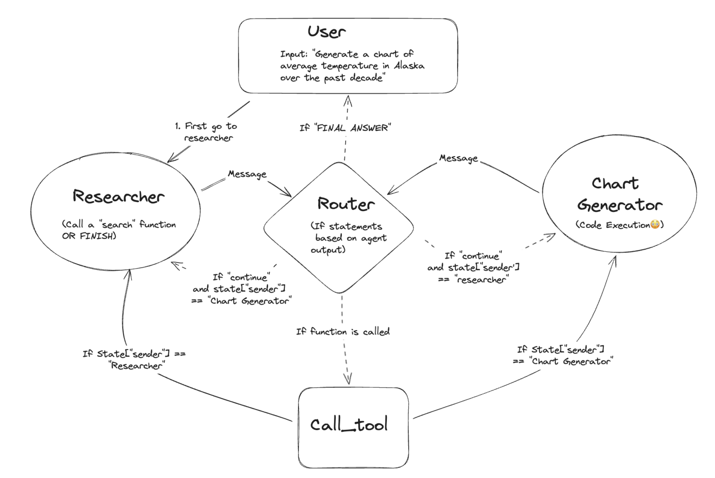
Multi-agent structures
Cooperating agents

Slide 4
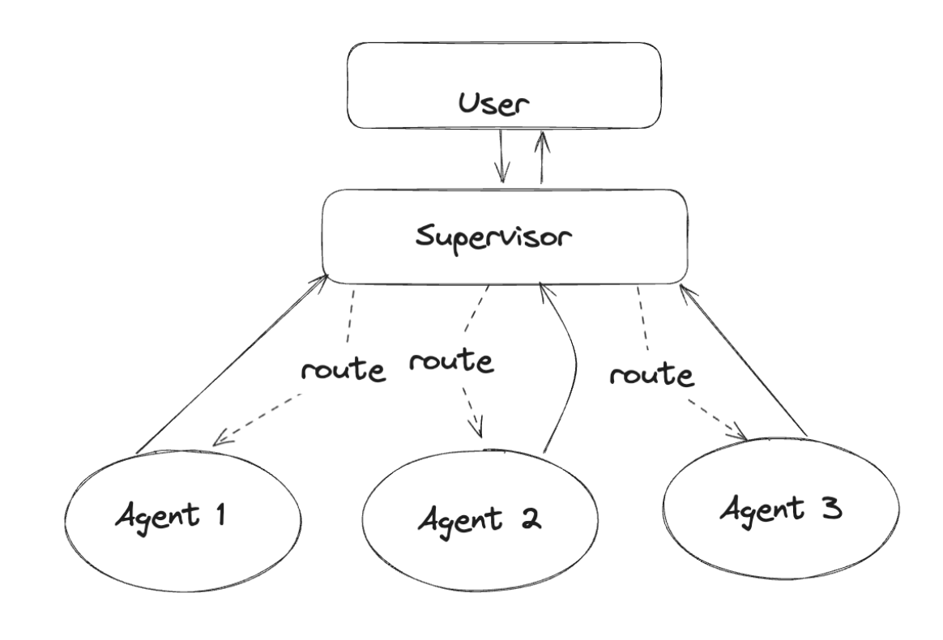
Multi-agent structures
Supervisory agent

Slide 5
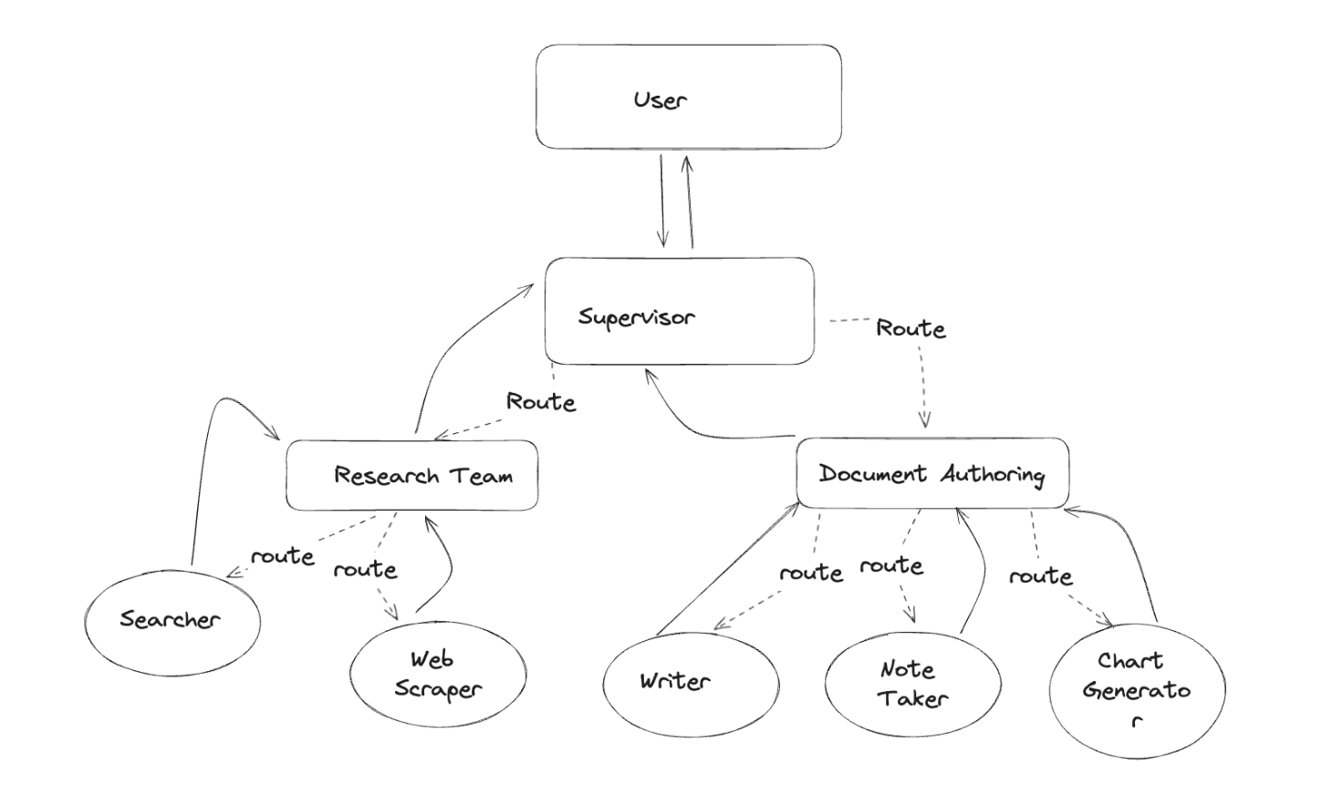
Multi-agent structures
Hierarchical teams

Slide 6

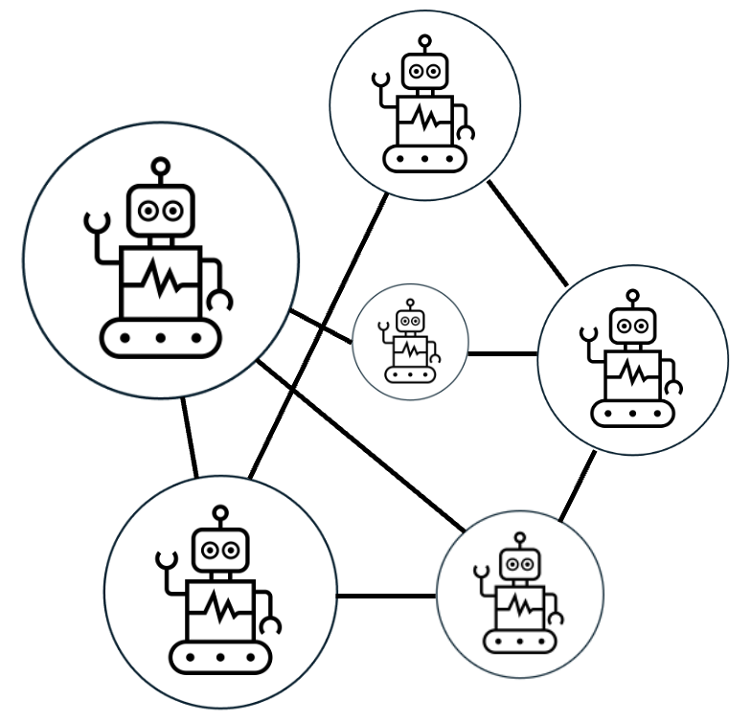

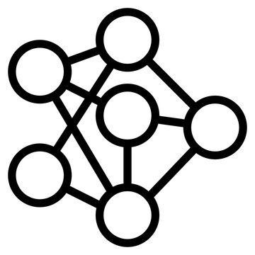

Narzędzia
+
Model językowy
Agent
Agentic AI

Slide 7




Tools
+
Language Model
Agent
Agentic AI

Slide 8
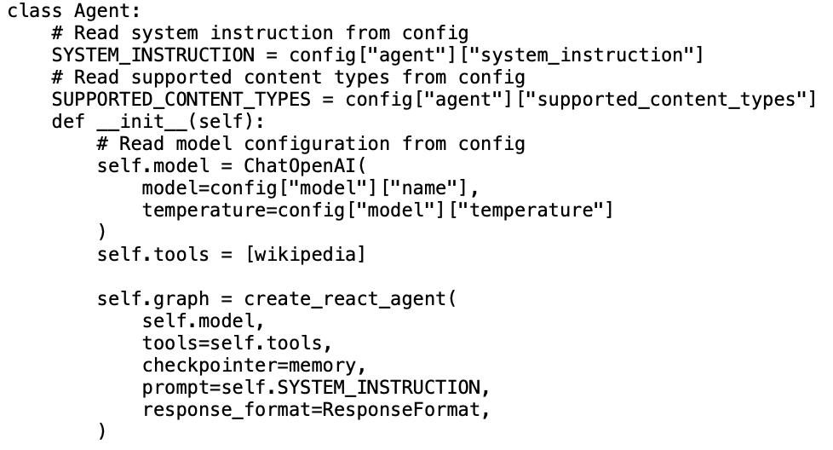

Slide 9
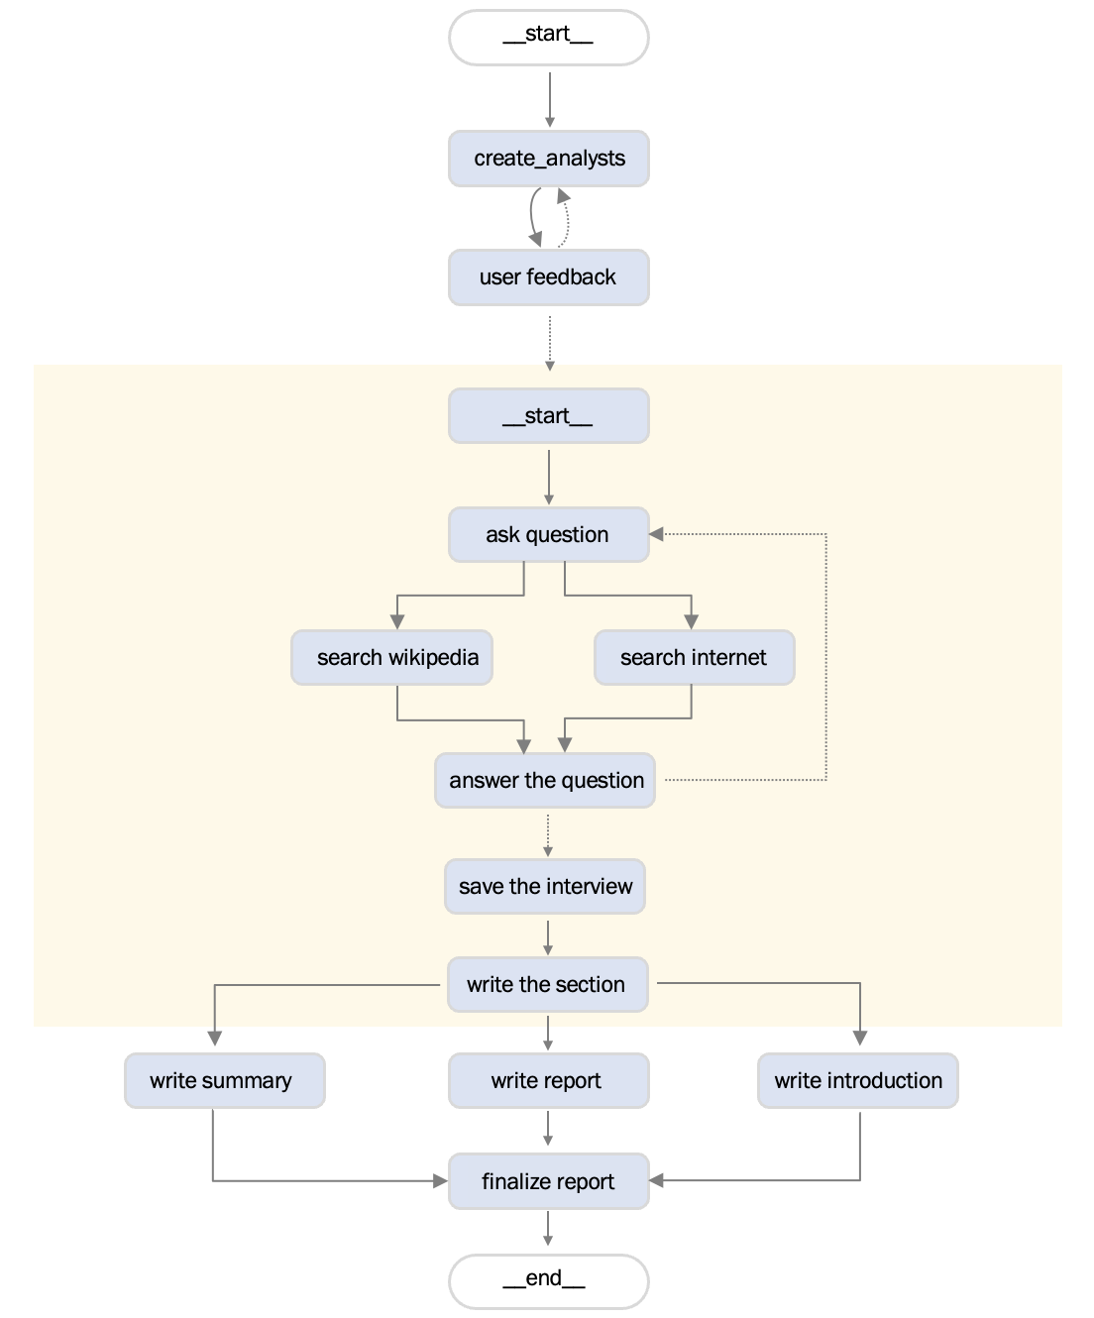

Slide 10
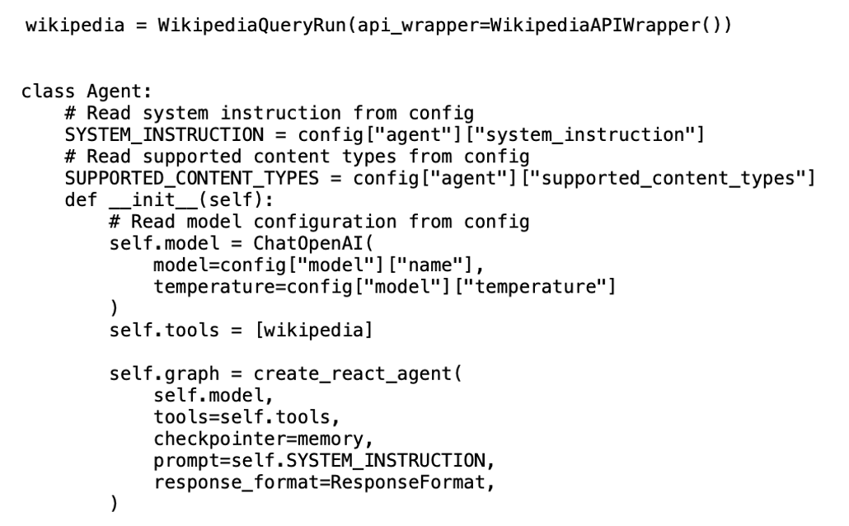
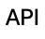
Agent needs to communicate

Slide 11
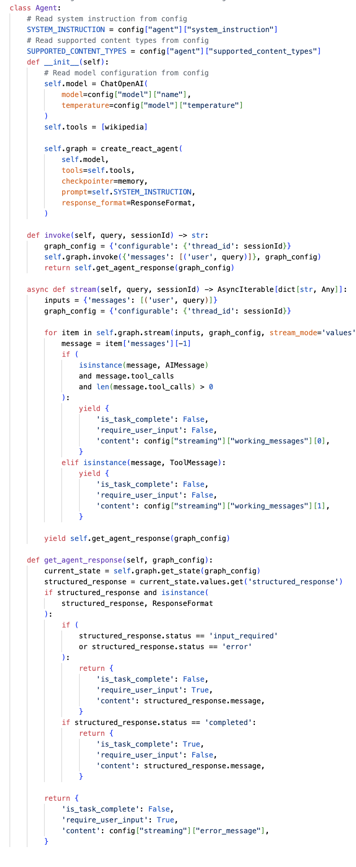

Slide 12
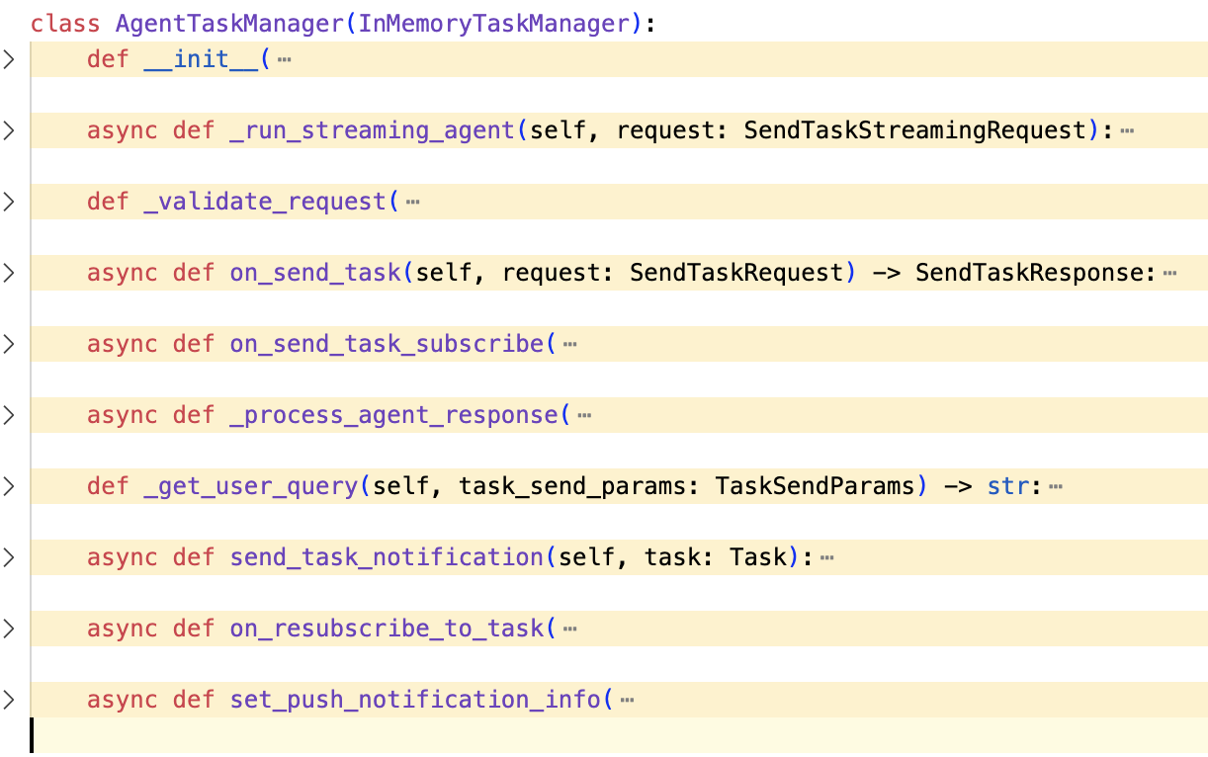
This communication needs to be managed

Slide 13
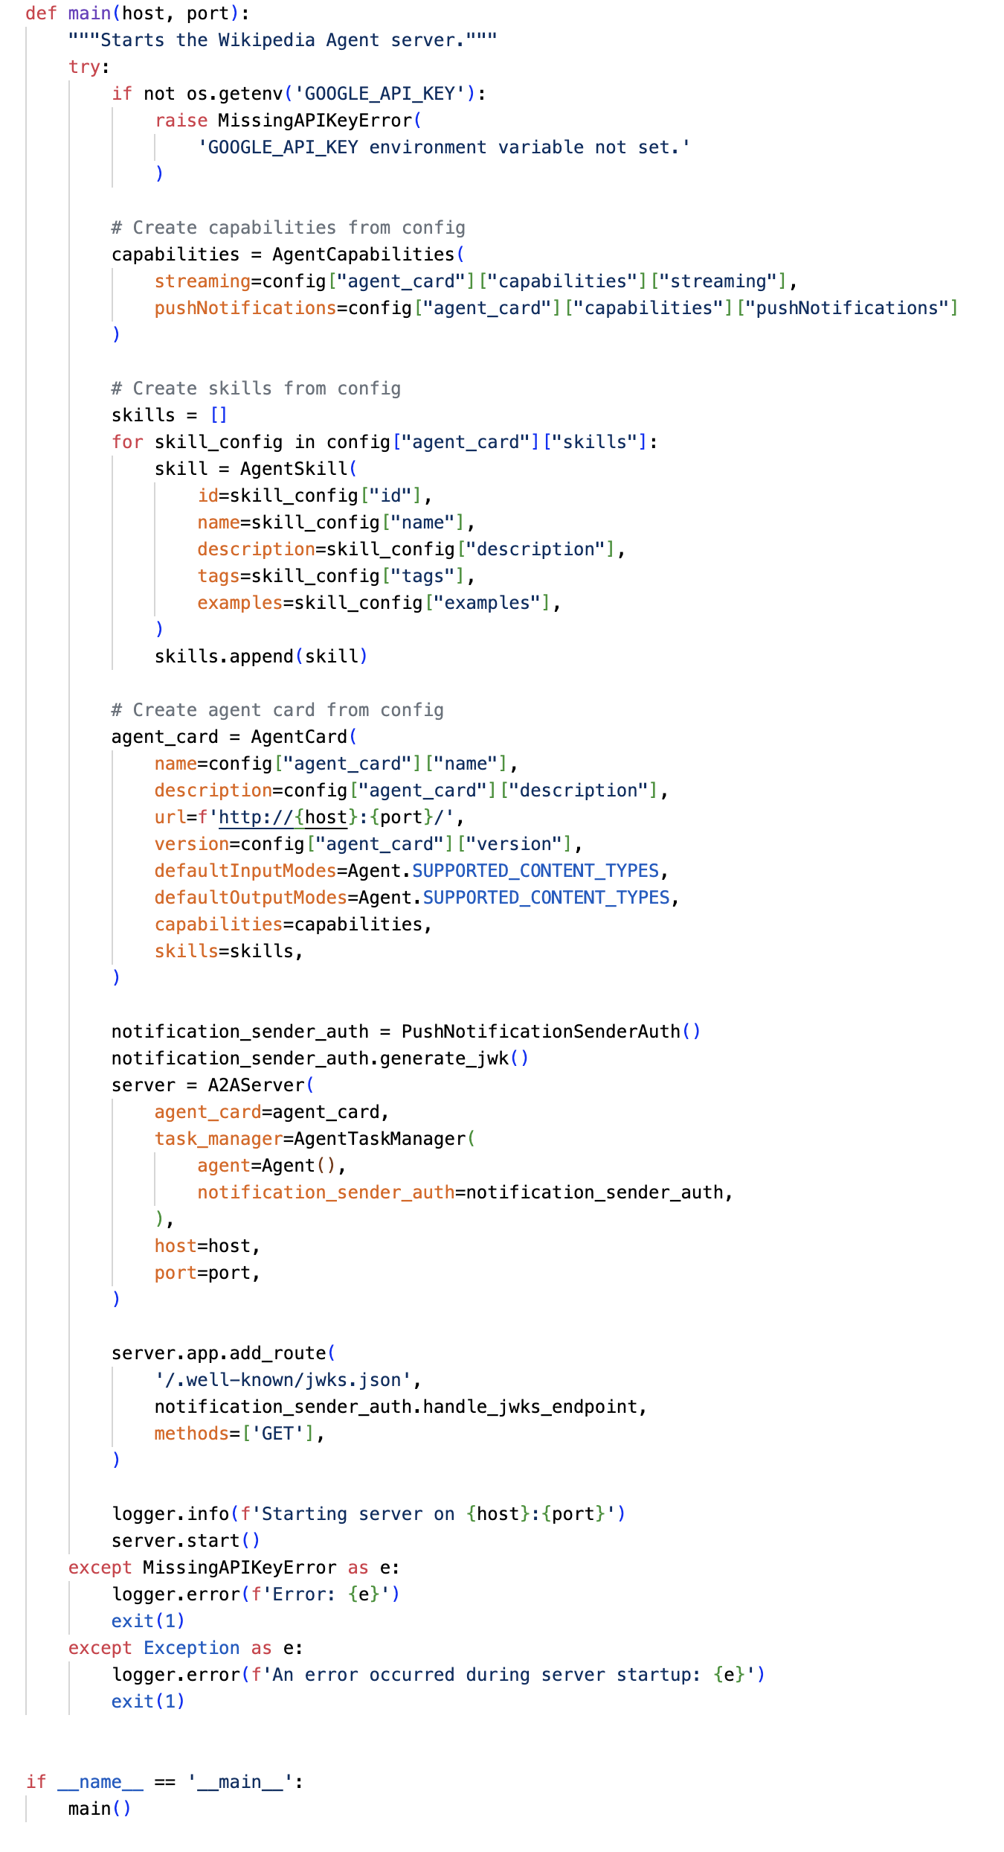
Agents needs to broadcast its skills and capabilities…

Slide 14
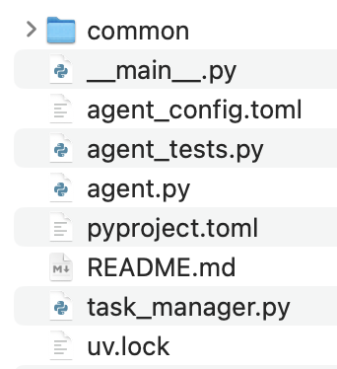
… and serve its services

Slide 15
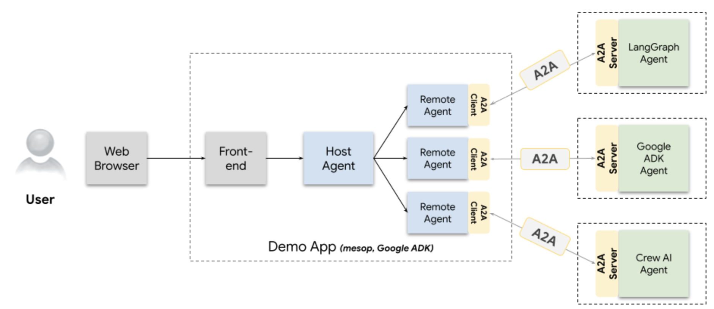

Slide 16
Control points

Slide 17
Agent
purpose
graph
LLM/SLM
deployment

Slide 18
Server
skills
deployment
capabilities
scoring
…

Slide 19
Logging
Metrics
Evaluation
Communication

Slide 20
Multi-agent logic

Slide 21
Web GUI
Frontend
Monitoring
…

Slide 22
Challenges

Slide 23
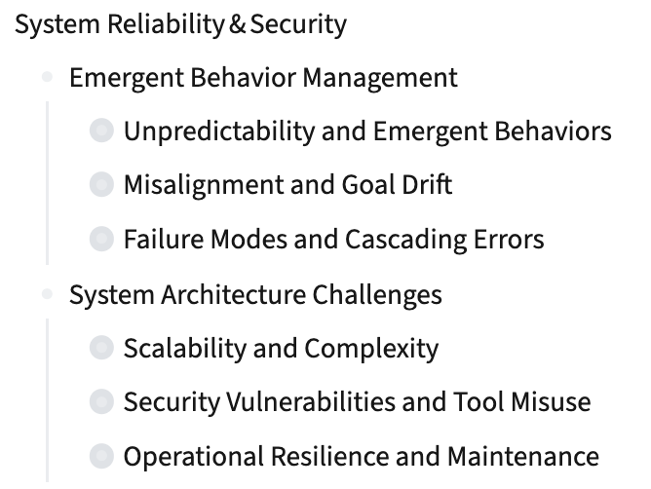

Slide 24
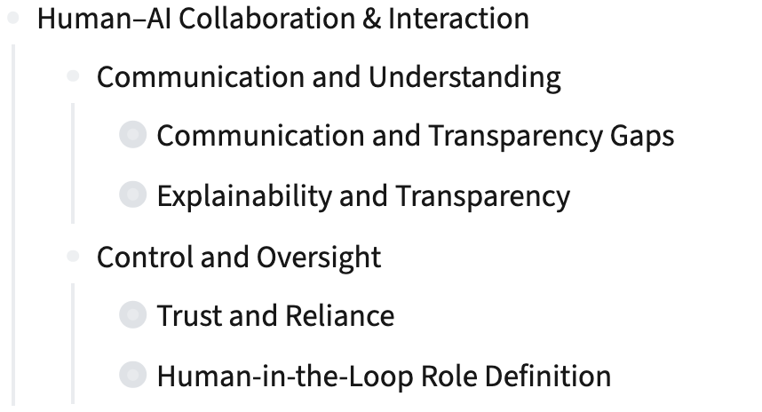

Slide 25
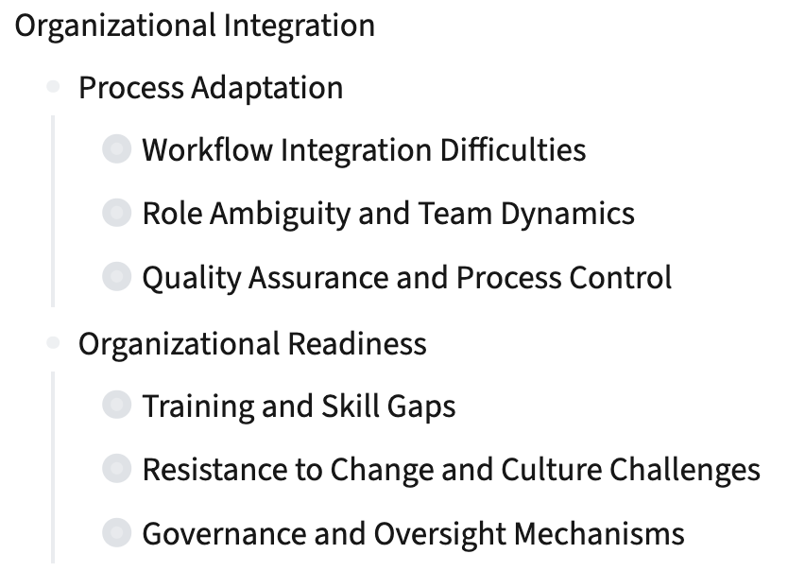

Slide 26
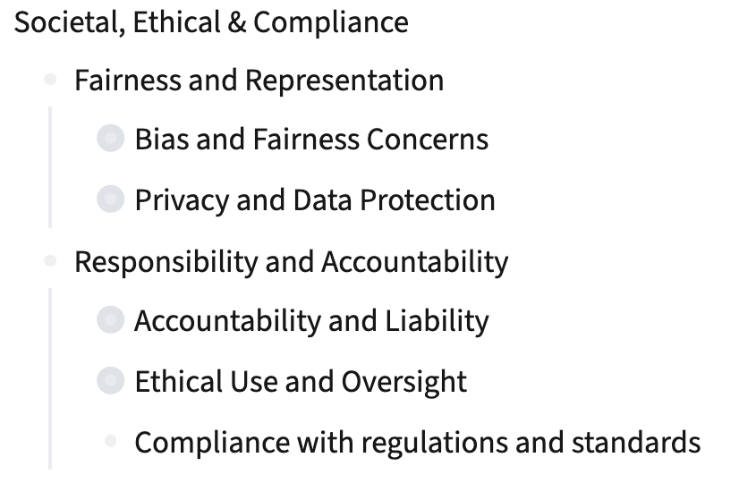

Slide 27
Evaluation Framework
Challenges > Metrics

Slide 28
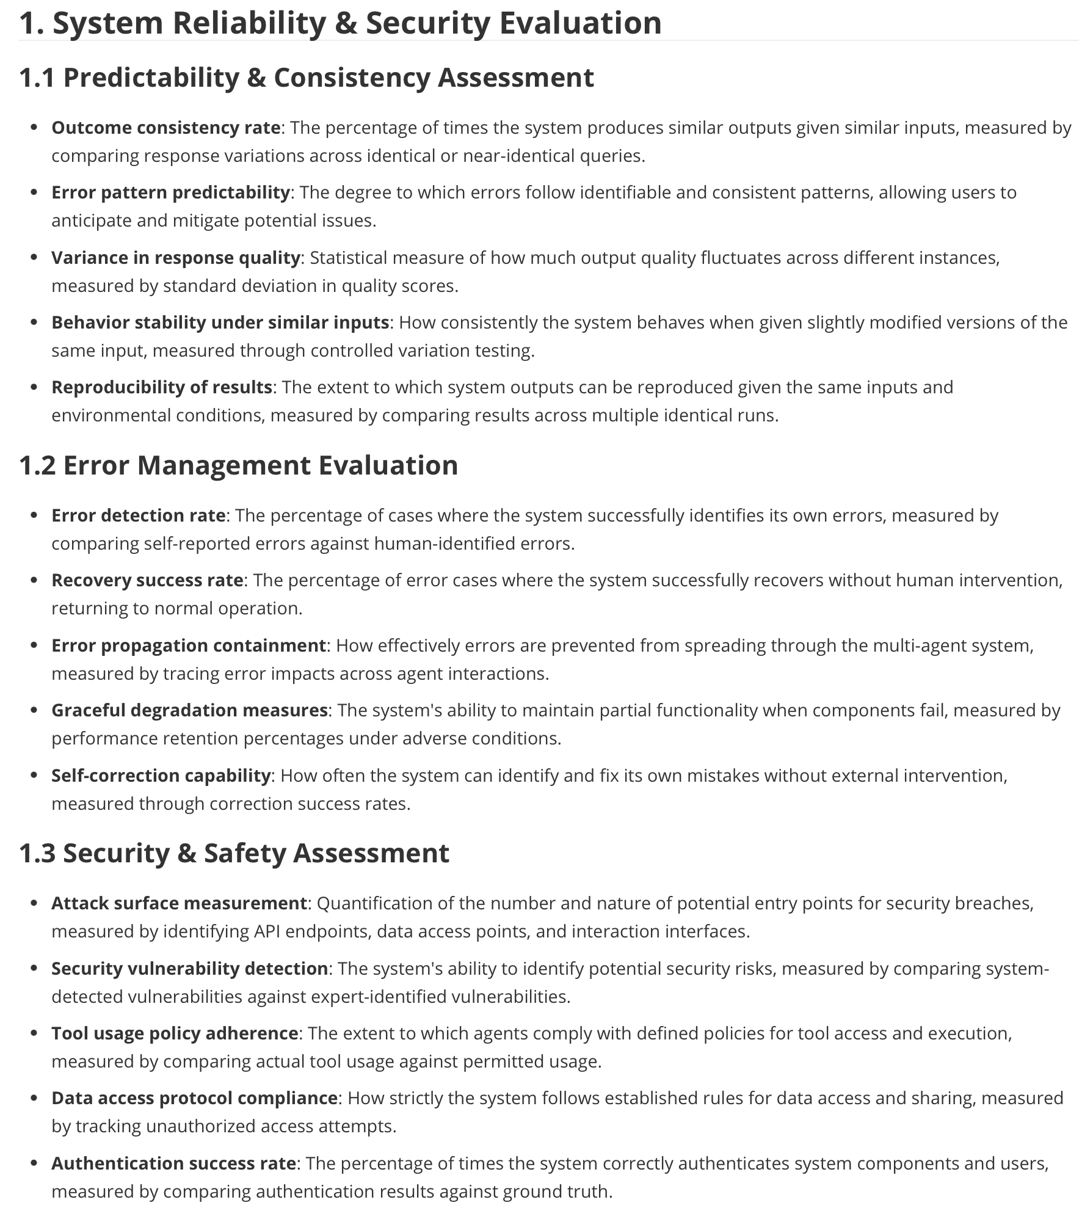

Slide 29
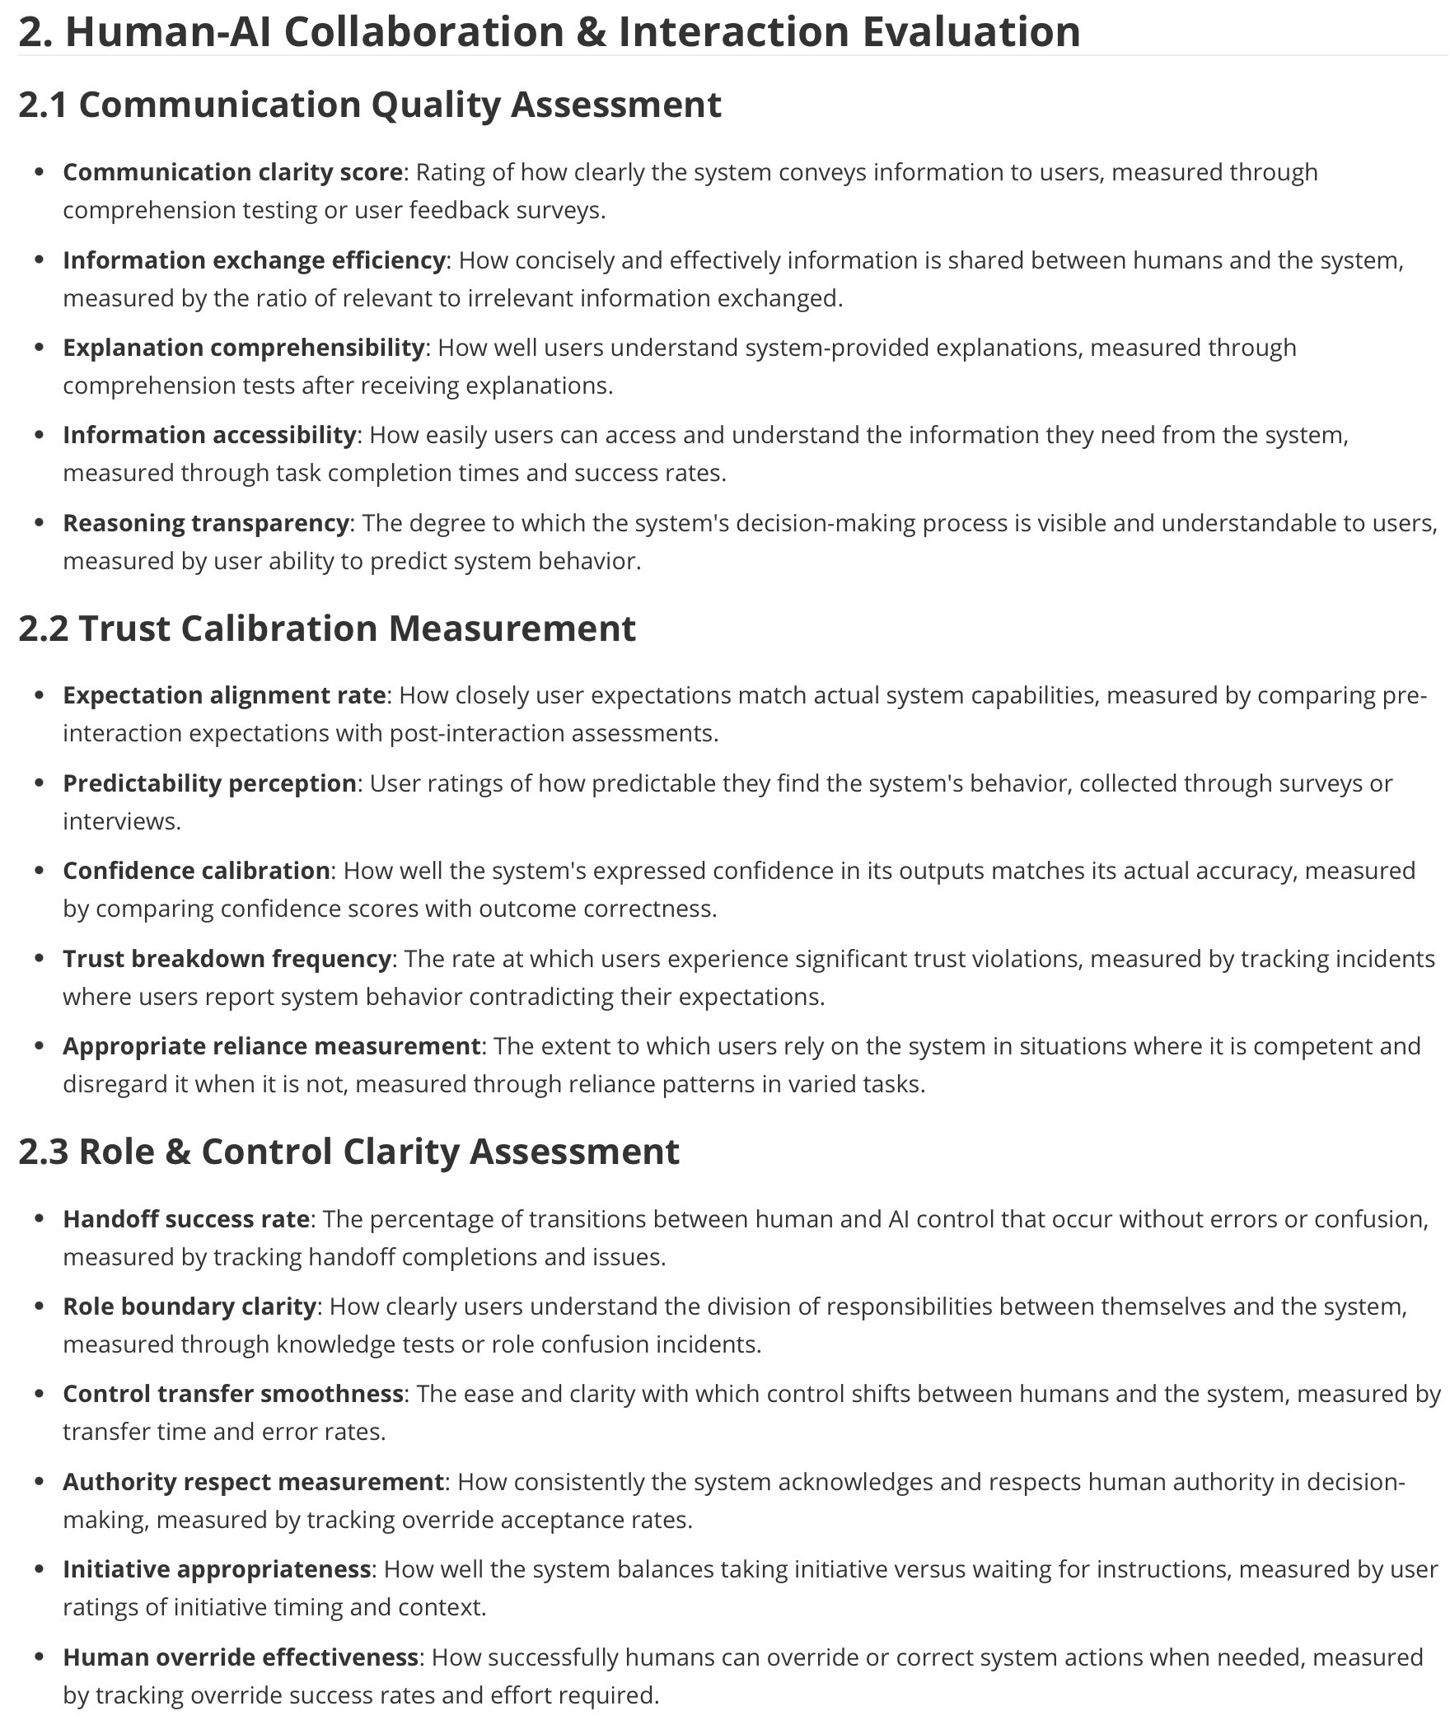

Slide 30
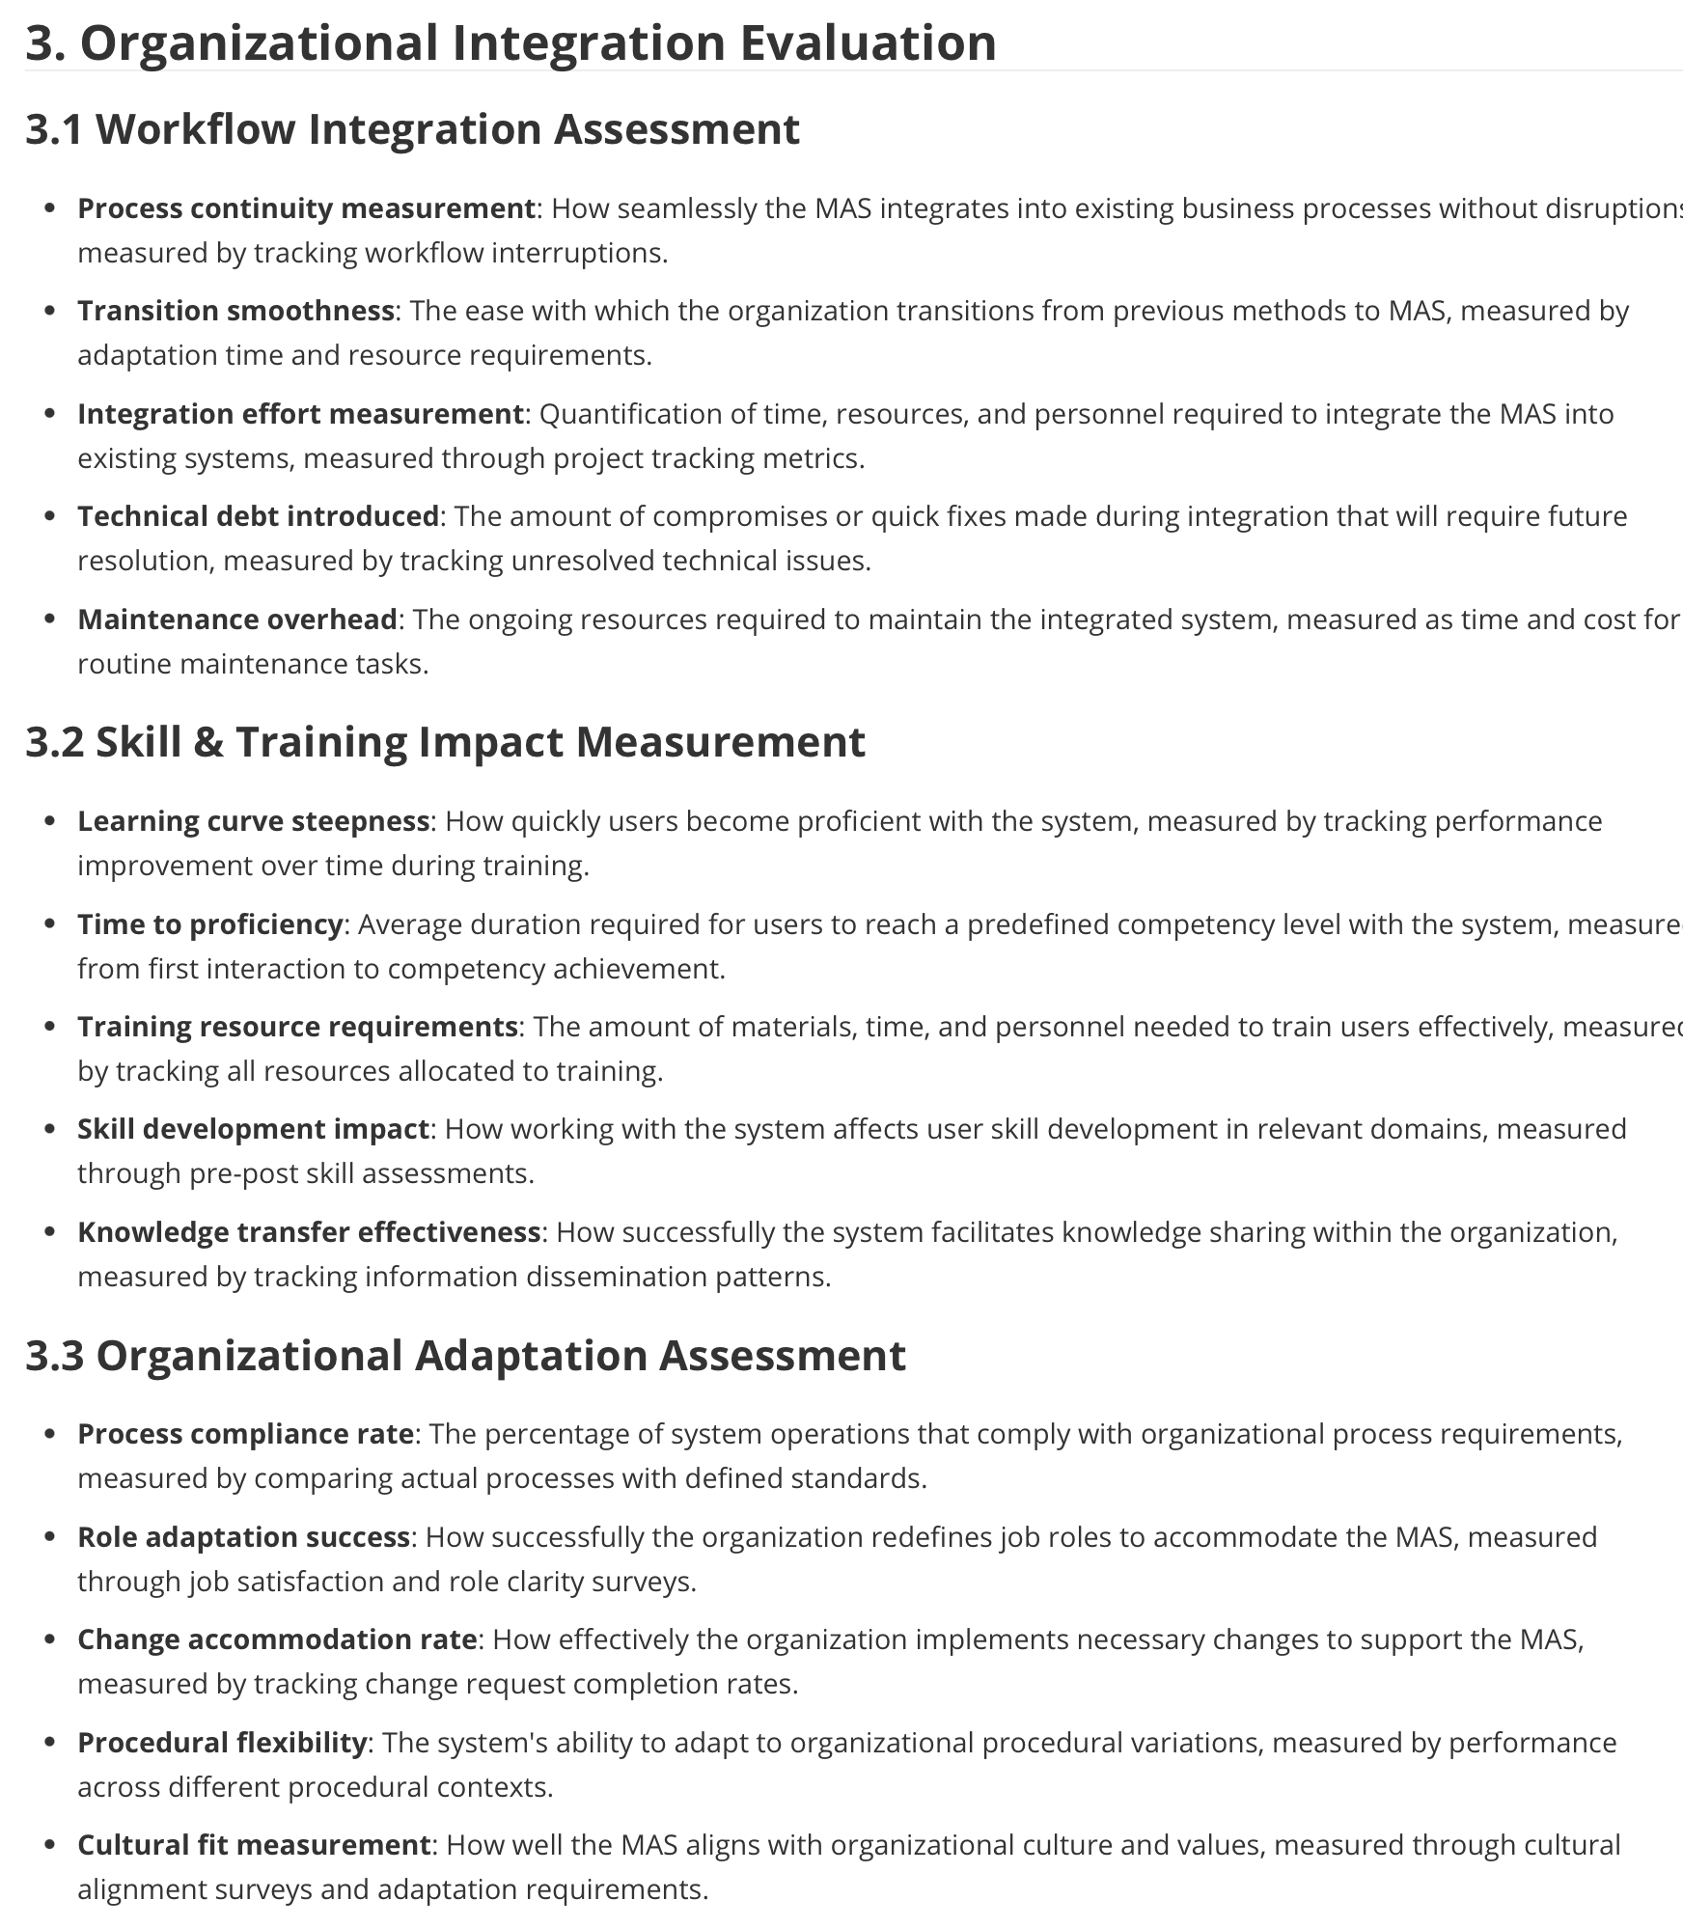

Slide 31
